Slide 1
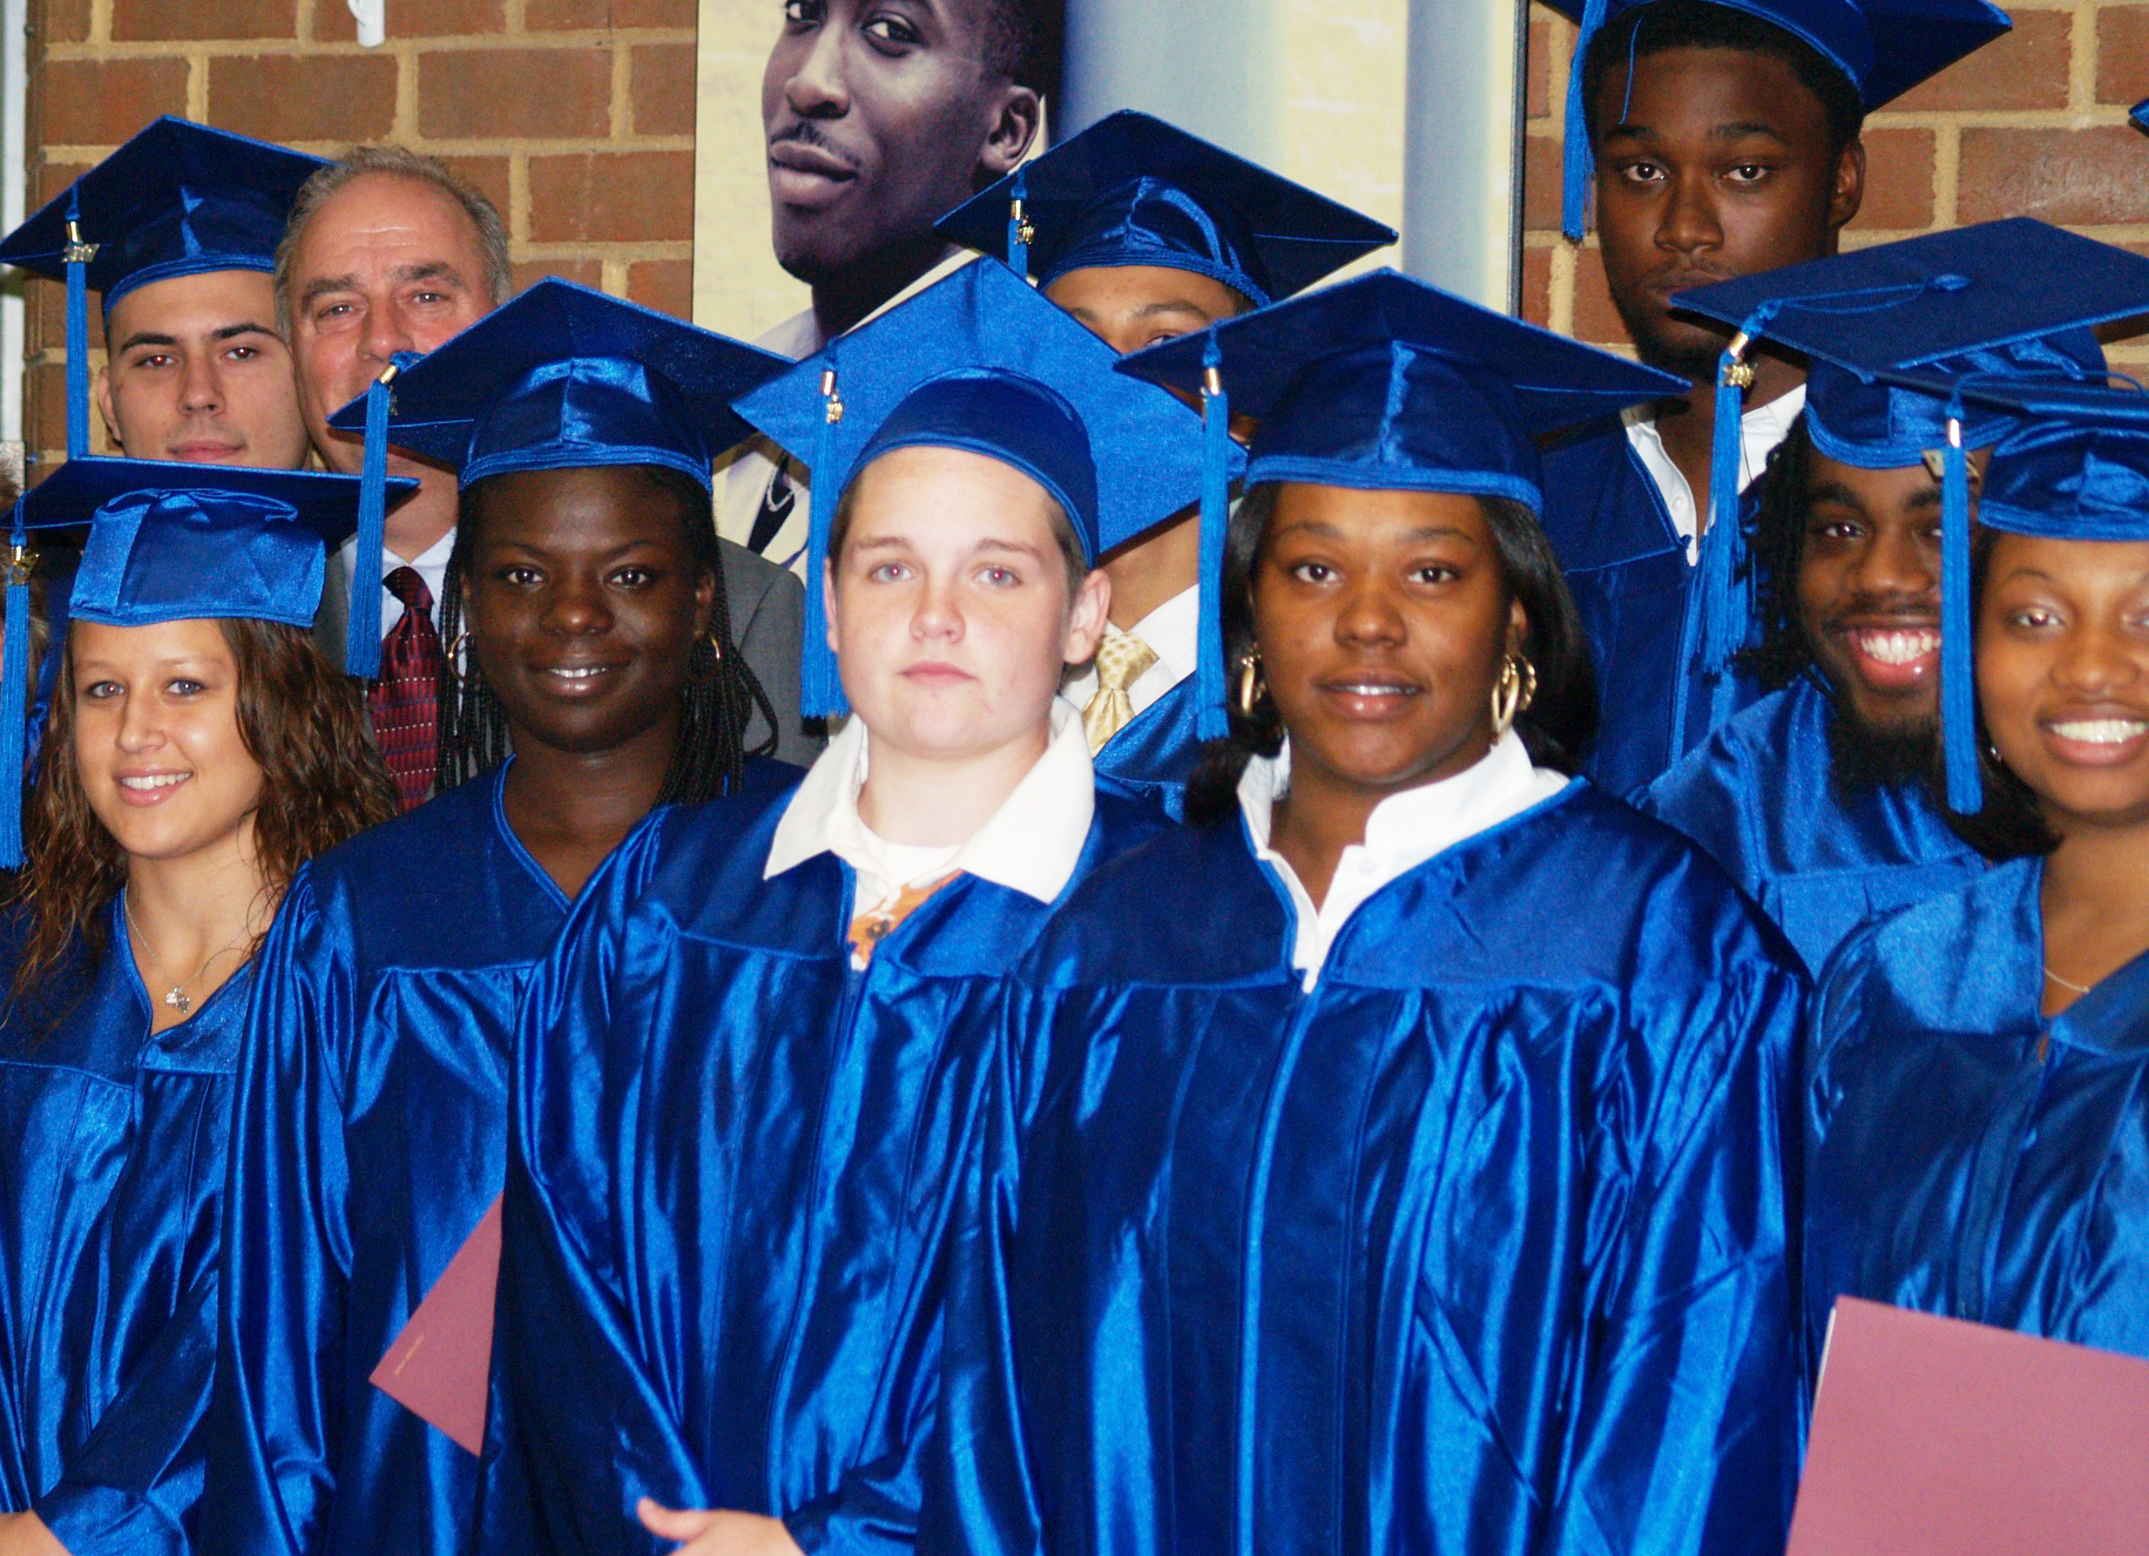


Developing Student Research Skills Through Online Library Resources
J. Sargeant Reynolds Community College, Richmond, Virginia
Hong Wu, Coordinator of Information Literacy and Digital Services
Denise Woetzel, Reference / Information Literacy Librarian
Beth Bensen-Barber, Assistant Professor of English
Josh Watson, English Instructor
The Art & Science of Online Education Conference J. Sargeant Reynolds Community College, Richmond, VA October 2012

Slide 2
Information Literacy Defined
"Information literacy is a set of abilities requiring individuals to recognize when information is needed and have the ability to locate, evaluate, and use effectively the needed information." - Association of College & Research Libraries (ACRL)
Notes:
Photo: http://ascplcl.wordpress.com/parents-and-educators/information-literacy-resources/

Slide 3
Successful integration of information literacy across the curriculum:
Librarians
Instruction
Assessment
Faculty

Slide 4
Impetus
late 1990s Governor’s Blue Ribbon Commission presents a charge to higher education institutions
2000 State Council of Higher Education for Virginia (SCHEV) establishes regular assessment & reporting requirements for core competencies
2002 Virginia Community College System (VCCS) Task Force develops guidelines for assessing core competencies
2003 VCCS administers James Madison University’s Information Literacy Test

Slide 5
Information Literacy Test Results (2003)
 | Number tested | Average Score | Median Score | Percent that met standard
VCCS | 3,678 | 36.4 | 37 | 24.40%
JSRCC | 511 | 31.18 | 31 | 16.05%

Slide 6
Dilemas
No institutional mandate or guidance was articulated on how to map information literacy within the curricula.
Information literacy instruction is dependent upon faculty requests.
Limited librarians on staff are available to offer instruction across the board.
One hour/one shot library instruction sessions produce limited results.

Slide 7
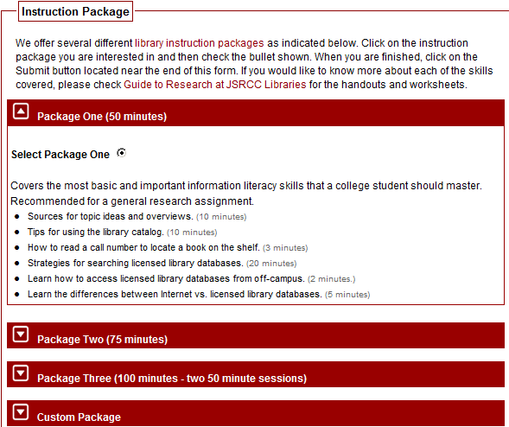
Responsive Measure 1
Enhanced instructional workshops provided upon faculty request.

Slide 8
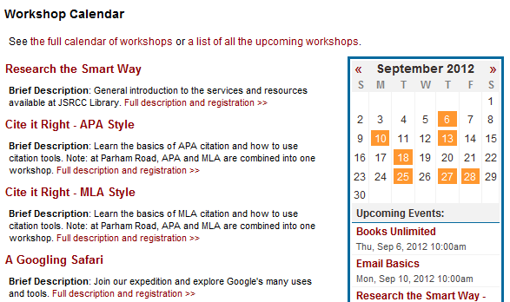
Responsive Measure 2
Responsive Measure 2
Offered students open session workshops.

Slide 9
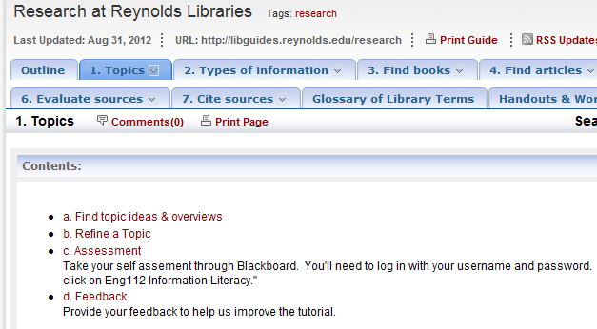
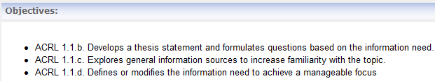
Responsive Measure 3
Responsive Measure 3
Developed online modules based on ACRL IL standards

Slide 10
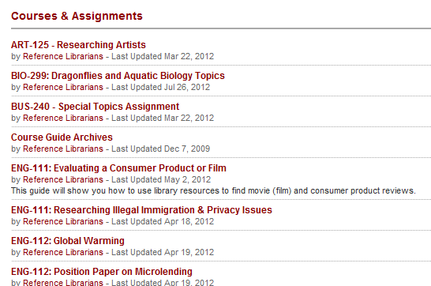
Responsive Measure 4
Responsive Measure 4
Created course-based and assignment-specific LibGuides

Slide 11
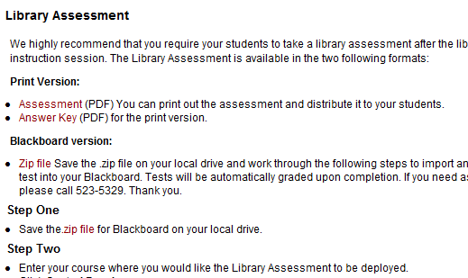
Responsive Measure 5
Responsive Measure 5
Created a 20-question assessment for students to complete after a library instruction session.

Slide 12
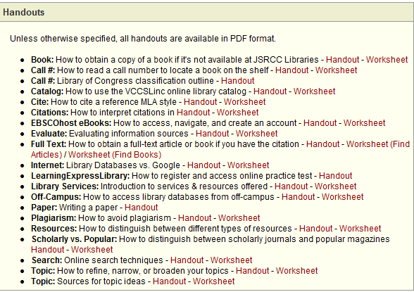
Responsive Measure 6
Responsive Measure 6
Created research handouts & exercise sheets.

Slide 13
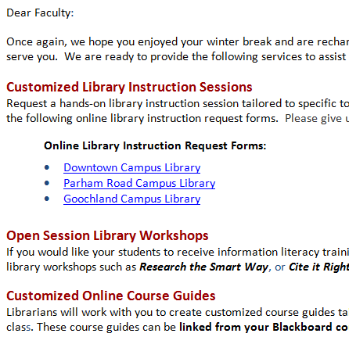
Responsive Measure 7
Responsive Measure 7
Emailed Information Literacy instruction reminders each semester.

Slide 14
Continuing Issues
Continuing Issues
Despite these efforts, JSRCC still
Had no institutional guidance or mandate for the effective delivery of information literacy skills or their necessary placements within the curricula.
Continued to struggle with the lack of coordinated collaboration between librarians & faculty.

Slide 15
Breakthroughs
Breakthroughs
JSRCC’s Quality Enhancement Plan (a five-year, institution-wide strategic plan) focused attention on providing support for students within online courses & assessing student learning outcomes in distance courses.
Information literacy was identified as one of the SLOs that would be targeted & assessed.
This assessment effort is supported by a three-year federal grant, Funds for the Improvement of Post-Secondary Education (FIPSE).

Slide 16


Breakthroughs
Breakthroughs
Librarians & faculty members began to engage in active conversations at QEP Subcommittees.

Slide 17
Managing Guidelines
Managing Guidelines
Student instruction should cover core information literacy competency skills as identified by SCHEV.
Instructional elements should be easy & flexible to implement across curricula.
Instructional materials should lend themselves to ease of evaluation, revision, & updates.
Instructional materials should be available for online delivery to reach both on-campus and distance students.
Assessments & data collection should not be cumbersome for faculty.

Slide 18
Modules Adopted
Modules Adopted
Research at Reynolds Libraries IL modules based on standards/skills covered in:
ACRL’s IL Standards
VCCS Core Competency Standards for IL
James Madison University’s Go for the Gold Tutorial and Information Literacy Test (ILT).
VCCS Libraries’ Connect for Success Tutorial

Slide 19
Implementation (Part One)
Defining the Information Literacy Project

Slide 20
Collaborative Efforts: Librarians’ Perspective
Collaborative Efforts:
Librarian’s Perspective
Identified Eng112 as our target course for assessment.
10 assessment questions were created for each of the 7 modules.
Librarians from both within & outside of JSRCC reviewed all 7 modules as well as the assessment questions for each module.
Modules & questions were revised based on the initial reviews.
English faculty were invited to review the modules & assessment questions. Further revisions were made.

Slide 21
Collaborative Efforts: Librarians’ Perspective (continued)
Collaborative Efforts:
Librarian’s Perspective (continued)
30 assessment questions were developed for the pre/post test. English faculty provided feedback on which questions to include.
Feedback Survey questions were developed for each module.
A Camtasia clip was developed to provide students with instructions for navigating & completing the modules.
Librarians entered all seven modules & assessments into Blackboard.

Slide 22
Implementation (Part Two)
Integrating English Department Faculty

Slide 23
Collaborative Efforts: Faculty Perspective
Collaborative Efforts: Faculty Perspective
English Faculty Subcommittee Chair mapped the seven modules into the Eng112 curriculum to provide participating faculty with guidance.
Nine previously successful Eng112 students were solicited to pilot test the modules in Fall 2011.
English faculty were recruited & trained to integrate the online modules into their course sections in Fall 2011.

Slide 24
Collaborative Efforts: Faculty Perspective (continued)
Collaborative Efforts: Faculty Perspective (continued)
Five faculty agreed to participate in the project as a control group.
No online Library Research Guides were integrated within the control sections.
Instructors taught IL skills as usual to their sections
One instructor integrated one library session for her section.
Control group included urban & suburban students but no distance or dual students.
Students completed pre- & post-assessments.

Slide 25
Participating ENG112 Sections Represented Varied Course Delivery Formats
Participating ENG112 Sections Represented Varied Course Delivery Formats

Slide 26
All JSRCC Campuses were Represented
All JSRCC Campuses were Represented

Slide 27
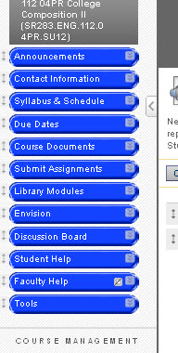
Integration
Integration
Blackboard
Integrated pre- and post-tests
Integrated all seven modules
Integrated all seven assessments
Revised syllabi to include due dates for reading and taking assessments
Integrated into BB Gradebook

Slide 28
Faculty Training
Faculty Training
Extensive communications to introduce project to faculty & invite participation
Two Training Workshops for Faculty
ENG112 Outcomes stressed
Sample course schedules (two options)
Textbook integration handouts
How-to Blackboard integration (course copy)
Directions for submitting pre- & post-assessment scores to Coordinator

Slide 29
IMPACT
What did we learn?

Slide 30
Measuring the Value of Providing Information Literacy Instruction in ENG112
Both sets of students – the Control Group as well as the Treatment Group – entered ENG112 at comparable levels of competency in research skills.
The data confirms that ENG112 is an appropriate site for instruction in information literacy skills: students enter ENG112 with some basic understanding of research skills but not enough to demonstrate competency in this area of learning.

Slide 31
Students make significant improvement in IL Skills in ENG112
Students make significant improvement in
IL Skills in Eng112
Post-test Results: Both the Treatment Group and the Control Group made significant progress.
Control Group Improvement: 7.30 points, on average
Treatment Group Improvement: 20.15 points, on average.
Treatment Group achieved a solid level of “competency” in research skills, scoring 76%, on average.
Control Group neared “competency,” scoring 66%, on average.

Slide 32
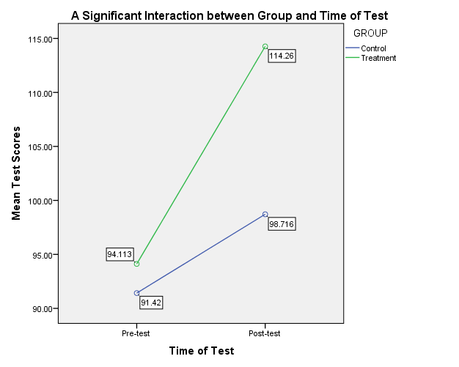
Notes:
This graph offers a visual of the significant difference in improvement between the control group and the treatment group. Clearly, both groups display improvement, but we can also see that the treatment group improves as a much higher rate. This suggests that with assistance from the modules there is greater room for success.

Slide 33
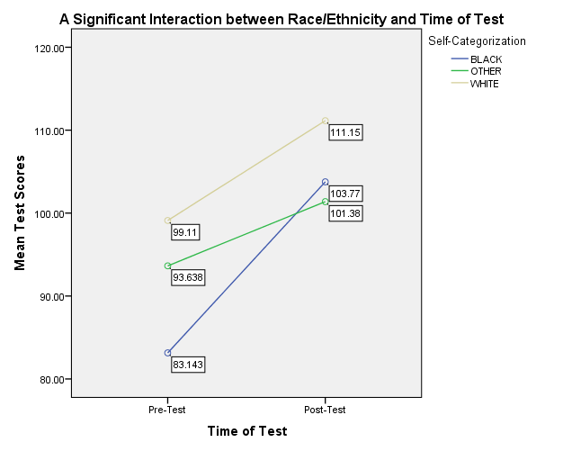
Significant and Observable Effects for African American Students
Significant and Observable Effects for African American Students
Notes:
The most significant impact was observed upon skills development of African American students. The steepness of the slope for our African American students suggests that while the pre-test reveals much lower scores, improvement is significantly higher in the post-test.

Slide 34
The Good News
The Good News
ENG112 is having a direct & significant impact on student learning outcomes in the area of information literacy.
The integration of online library research guides within ENG112 results in even more significant gains for students in research skills.
African American students begin ENG112 with a skills disadvantage when compared to Caucasian students & to students classified as “Other.” However, African American students make:
1. the most significant gain in learning by the end of a semester,
2. surpass the “Other” category, and
3. reach very close to “competency” level by time of post-test.

Slide 35
Testimony of a Former Student
Testimony of a Former Student
Hey Mr. JSRCC Instructor,
Just wanted to let you know that at JMU we had to take a information skills test and go through all of these modules. I didn't even have to go through any of the modules because we already did basically the same thing in your class this spring. Passed with scores of 4, 4, 5, 4 and 4 out of 5.
Thanks!!!!!!!!
Former JSRCC Student

Slide 36
What We Learned and Where We are Going
What We Learned and Where We are Going
The data supports the need to initiate policy discussions now for the effective integration and delivery of information literacy skills to students throughout the curriculum.
English Department faculty will develop a task force to promote the systematic integration of all library research guides within all ENG112 sections.
Other discipline faculty are being introduced to the effective integration of the Library Research Guides.

